Slide 1
Welcome to Live Lecture
Moderator: Gina Cooper
Agenda Week 2
Making Decisions
Decisions in flowcharts
Complex decisions
Questions

Slide 2
Decisions
Often in programs decisions must be made based on input or the result of a calculation or comparison
Conditional expressions = produce a boolean result that is either true or false
If/else = dual selection (can be nested)
Examples:
If(hoursWorked>40)
If(GPA>3.5)

Slide 3
Relational (comparison) operators
less than <
less than or equal <=
greater than >
greater than or equal >=
Equal (comparison) ==
not equal !=
These values allow you to compare data
Please note: Assignment mathematical operator is =
Note: !(x < y) is logically the same as x >= y

Slide 4
Syntax example for if…else statement
note use of lowercase
for keywords
if (i == 3)
{
a = a + 1;
}
else
{
a = a – 1;
}
note where the semicolons
are and are not applied!!

Slide 5
Flowchart
Oval
Shows your program's starting or ending point
Flowline/arrow
Shows your program's flow of logic
Parallelogram
Shows input to your program or output from your program
Rectangle
Shows that processing is being done by your program
Diamond
Shows that your program has to make a decision
Has two arrows coming out of it (true and false)

Slide 6
Visual Studio
Open Alderaan Volume problem from last week.
Add selection control structure after the radius input (radius = Convert.ToDouble(Console.ReadLine());)
if (radius < 0)
{
Console.Write( "Please enter the radius between 0 and 4000: ");
radius = Convert.ToDouble(Console.ReadLine());
}
else if (radius > 4000)
{
Console.Write("Please enter the radius between 0 and 4000: ");
radius = Convert.ToDouble(Console.ReadLine());
}
else
{
Console.Write("good radius") ;
}

Slide 7
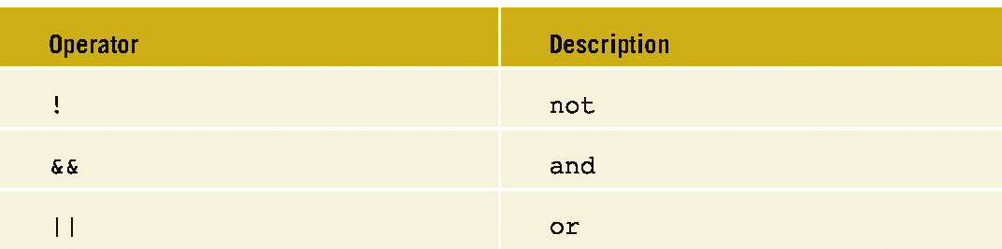
Combine into one selection control structure
if(radius<0 || radius>4000)
{
Console.Write( "Please enter the radius between 0 and 4000: ");
radius = Convert.ToDouble(Console.ReadLine());
}

Slide 8
Exercise: evaluate these logical expressions
Given that variables a = 2, b = 4, and c = 6, evaluate the following logical expressions to determine whether each result is true or false:
1. a == 4 || b > 2
2. 1 != b && c != 3
3. !(a > 2)
Please note what is not acceptable:
(examscore>78<90) INVALID
(78<examscore<90) INVALID
((examscore>78) && (examscore<90)) VALID

Slide 9
Logical operator evaluation
num = 1
If(num> 3 && num<10)
Are both evaluated?
If(num<3 || num>10)
When are both evaluated?

Slide 10
Nested if statements: flowchart example

Slide 11
Testing the Code
How should we test the values in the previous program?
Use a number line
Test values in each interval and the boundary conditions
Use Debugger – F11 in Visual Studio
0
4000
Minimum for good testing: -4, 0, 200, 4000, 5000

Slide 12
Multi-way selection
Multi-way selection chooses among several alternatives
Two constructs:
switch statement → typically used for evaluating selection conditions that are integer or character constants
else if → alternate style to nested if statements; can evaluate selection conditions over a range of values

Slide 13
Multi-way flowchart for a switch

Slide 14
Example
int num = 0;
Console.WriteLine("Enter selection (1 – 3): ");
num = Convert.ToInt32(Console.ReadLine());
switch (num)
{
case 1: Console.WriteLine( "I love cis170");
break;
case 2: Console.WriteLine( "I kind of like cis170");
break;
case 3: Console.WriteLine( "cis170 is okay" );
break;
default: Console.WriteLine( "default" );
break;
}
Note: case labels may be integers (1, 2, 3, etc.), or character constants (‘A’, ‘B’, ‘C’, etc.)

Slide 15
else if block example: flowchart
Note: else if can
evaluate values
over a range

Slide 16
Example: Grades
char grade;
double score = 0;
Console.Write("Please enter a score: ");
score = double.Parse(Console.ReadLine());
if (score >= 90.0)
{
grade = 'A';
}
else if (score >= 80.0)
{
grade = 'B';
}
else if (score >= 70.0)
{
grade = 'C';
}
else if (score >= 60.0)
{
grade = 'D';
}
else
{
grade = 'F';
}
Console.WriteLine("Grade is {0}", grade);

Slide 17
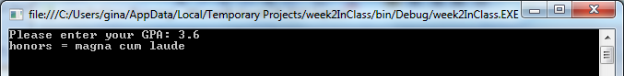
Scenario
Write a program that displays the honors a student might receive
Input: Prompt the user for their GPA Process: Determine their honor status. GPA between 3.5 and 3.59 is cum laude, between 3.6 and 3.79 is magna cum laude and between 3.79 and 4.0 is summa cum laude
Output: Display the honor status for EACH value of your testplan

Slide 18
double GPA;
Console.Write("Please enter your GPA: ");
GPA = Convert.ToDouble(Console.ReadLine());
if (GPA >= 3.5 && GPA < 3.6)
{
Console.WriteLine( "honors = cum laude");
}
else if (GPA >= 3.6 && GPA < 3.8)
{
Console.WriteLine( "honors = magna cum laude" );
}
else if (GPA >= 3.8)
{
Console.WriteLine( "honors = summa cum laude" );
}
else
{
Console.WriteLine( "sorry charlie!" );
}
Console.ReadLine();

Slide 19

Key concepts
Decisions
Boolean logic
Switch statements

